Slide 1
Standard Template Library
STL

Slide 2
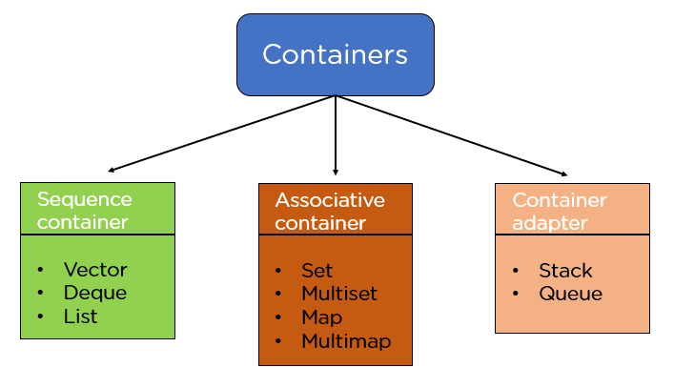
STL
The Standard Template Library (STL) is a set of C++ template classes to provide common programming data structures and function,
  such as lists, stacks, arrays, etc.
It is a library of container classes, algorithms, and iterators.

Slide 3
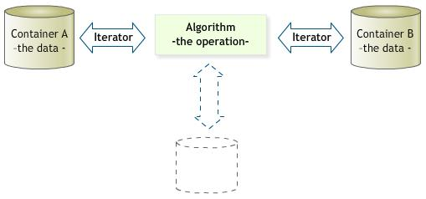
Standard Template Library
Three basic components of STL are:
  containers
  iterator
  algorithm

Slide 4
STL
Containers
  container are template classes for data storage
  many types of containers exist
  e.g., list for link list, vector for arrays and many more
Iterators
  Iterators are kind of pointers of STL
  They are used to point to the individual data items in the container for reading or writing
Algorithms
  to be discussed later on

Slide 5


Slide 6
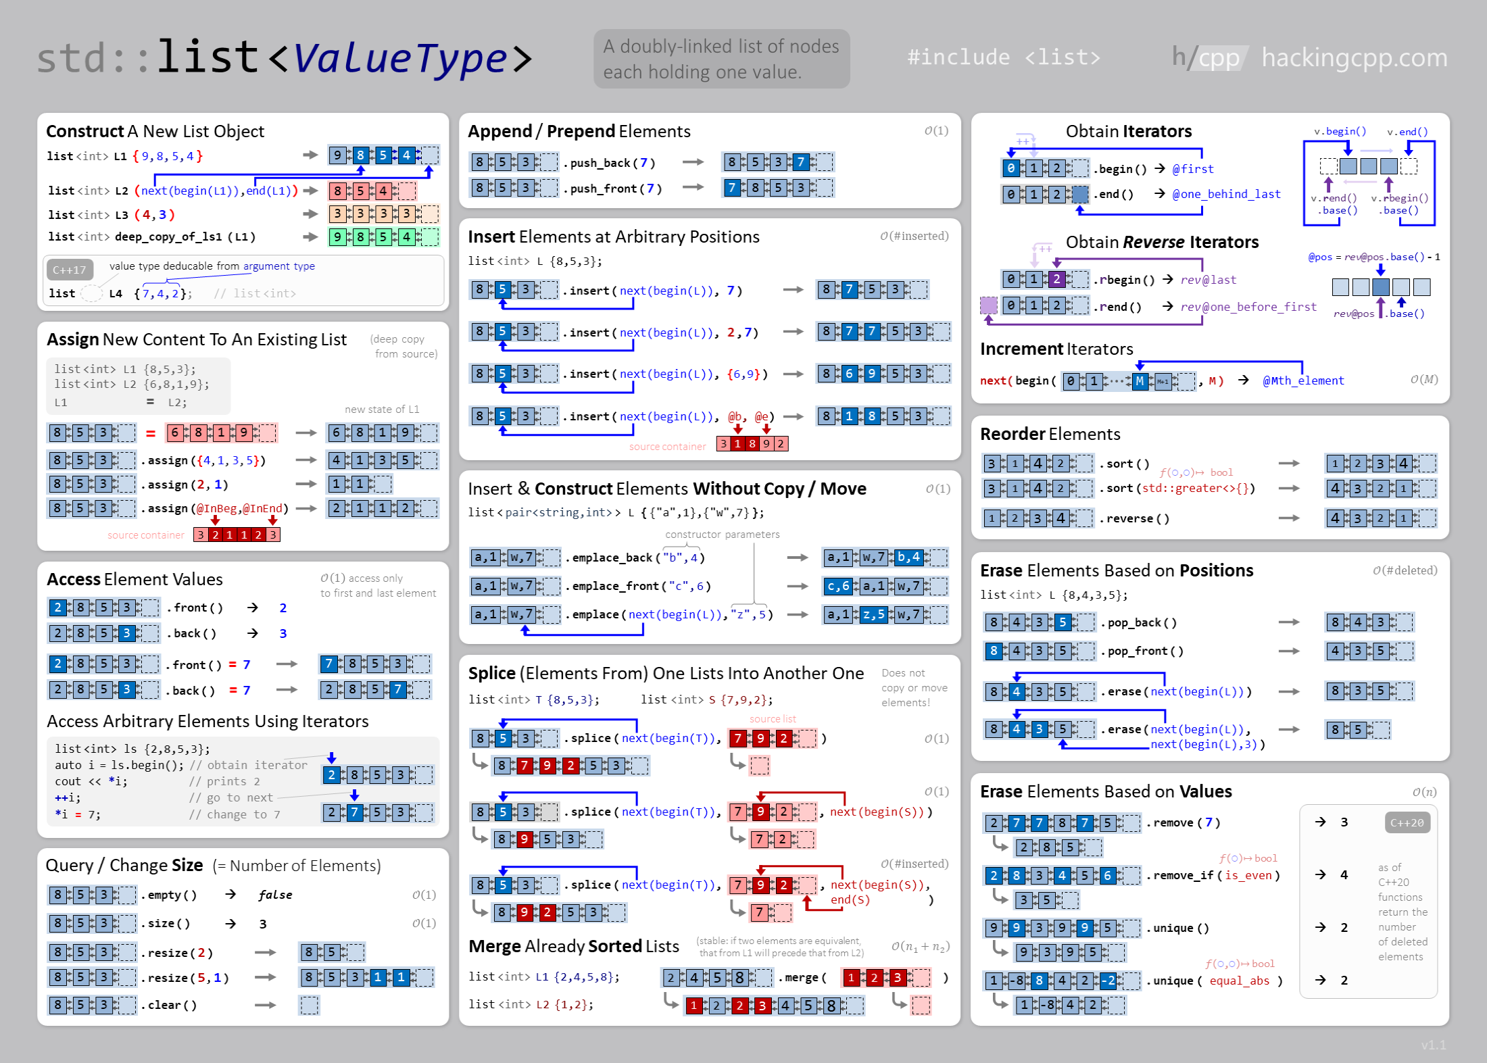

Slide 7
Some list member functions
push_back(data);
  inserts data at the end
push_front(data);
  inserts data at the front
pop_back( );
  deletes the last node
pop_front( );
  deltes the first node
Front()
  returns the data in the first node
Back()
  returns the data in the last node

Slide 8
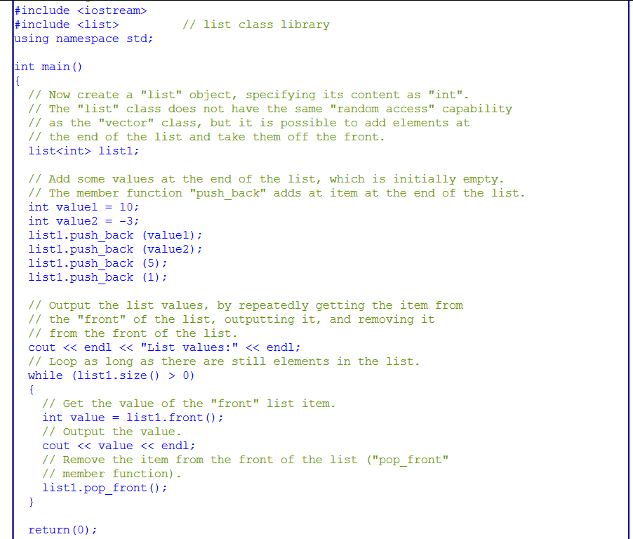
Example

Slide 9


list functions
insert(position, value);
erase(position)

Slide 10
iterator
list<int> intlist;
list<int>::iterator intlistitr;
Iterators can be initialized using list functions
intlistitr = intlist.begin();
now the iterator point to the first element of the list
intlistitr++
  it will take the iterator to the next object
*intlistitr
  dereferencing the iterator to access the data
advance(itr, steps)
// Incrementing itr2 by 3 positions
advance(itr2, 3);

Slide 11
Example
list<int> int_list;
int_list.push_back(1);
int_list.push_back(1);
int_list.push_back(8);
int_list.push_back(9);
int_list.push_back(7);
int_list.push_back(8);
int_list.push_back(2);
int_list.push_back(3);
int_list.push_back(3);
list<int>::iterator list_iter;
list_iter = int_list.begin();
list_iter++;
list_iter++;
int_list.insert(list_iter, 100);
//cout<<*list_iter;

Slide 12
Example
list<int> int_list;
int_list.push_back(1);
int_list.push_back(1);
int_list.push_back(8);
int_list.push_back(9);
int_list.push_back(7);
int_list.push_back(8);
int_list.push_front(2);
int_list.push_front(3);
int_list.push_front(3);
int_list.pop_back();
int_list.pop_front();
list<int>::iterator list_iter;
for(list_iter = int_list.begin(); list_iter != int_list.end(); list_iter++)
cout<<*list_iter<<endl;

Slide 13
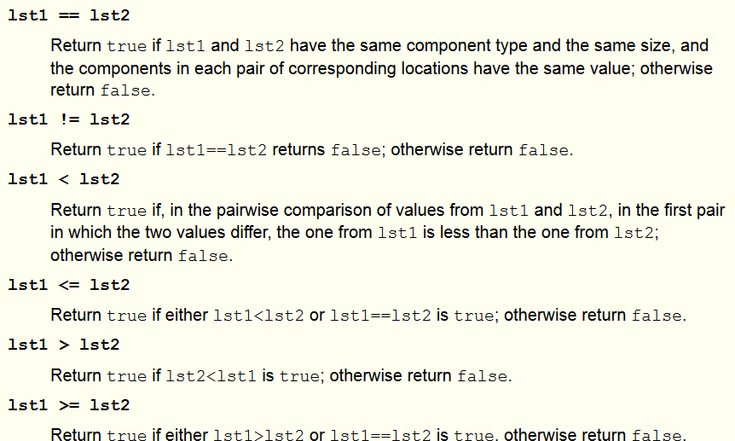
Relational Operator overloaded

Slide 14
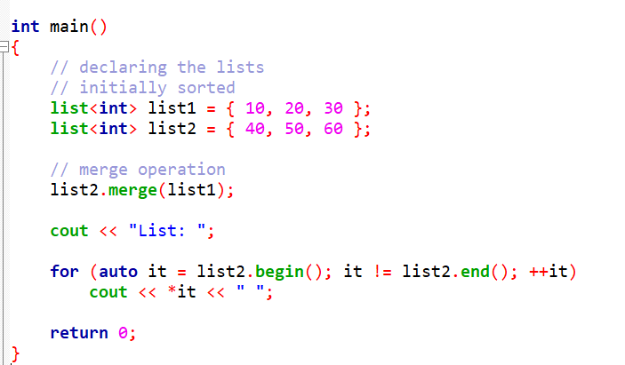

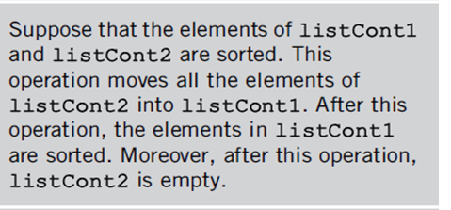

merge()

Slide 15
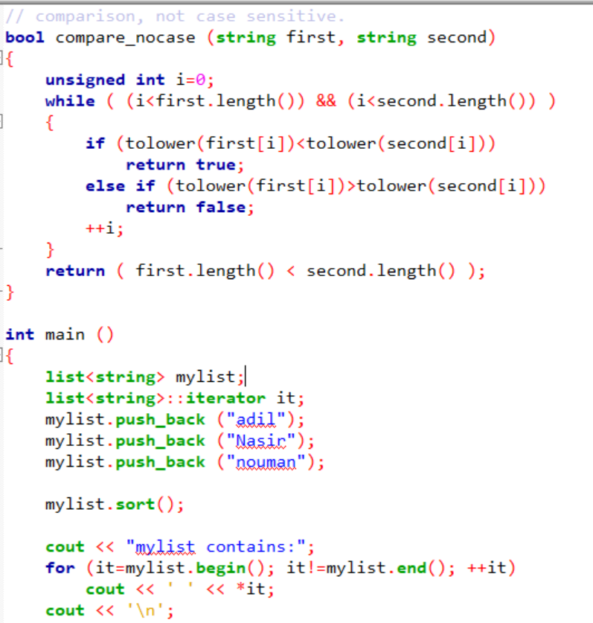
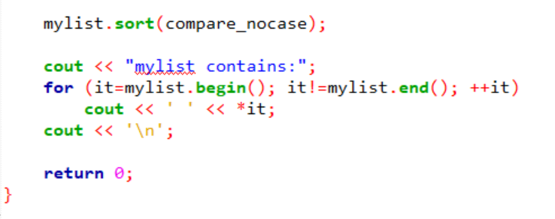
sort()

Slide 16
splice
#include <iostream>
#include <list>
using namespace std;
int main ()
{
list<int> list1 = {1,2,3,4};
list<int> list2 = {5,6,7,8};
list<int>::iterator it;
it = list1.begin();
++it; //pointing to second position
list1.splice(it, list2);
/* transfer all elements of list2 at position 2 in list1 */
/* now list1 is 1 5 6 7 8 2 3 4 and list2 is empty */
list2.splice(list2.begin(), list1, it);
/* transfer element pointed by it in list1 to the beginning of list2 */
/* list2 is now 5 and list1 is 1 6 7 8 2 3 4*/
return 0;
}

Slide 17
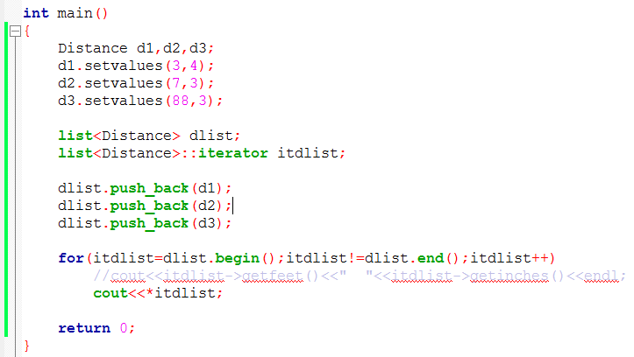
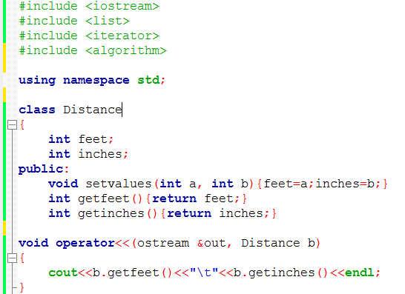

Slide 18
For complete list of list functions, visit cppreference.com

